Slide 1



Computer Networks
Prepared & Presented by: Mirlan Nurbekov, Lecturer
Office hours: Friday 9:00–17:00
AlaToo IT & Business College
Fall 2025

Slide 2
Encapsulation, addressing & core internet protocols
How data moves through layers (encapsulation)
How devices and apps are identified (MAC, IP, Port)
How TCP and UDP deliver data
What HTTP, FTP, DNS, DHCP actually do

Slide 3
Recap of previous lessons
Computer network = devices connected to share data and resources
OSI model: 7 layers (P, D, N, T, S, P, A)
TCP/IP model: Application, Transport, Internet, Network Access
Key idea:
Each layer has a specific job
Layers cooperate to deliver data from one program to another

Slide 4
What happens when you click “Open Website”?
The device (PC or phone)must:
Find the server’s IP address
Figure out how to reach it
Send the request to the correct application on that server

Slide 5
What happens when you click “Open Website”?
To do this, the network uses:
Encapsulation
Different kinds of addresses
Many protocols working together

Slide 6
Layers talk to layers
A conversation between peers
Each layer has a “friend” on the other device (peer layer)
They agree on rules = protocols
Example:
Your HTTP layer ↔ server’s HTTP layer
Your TCP layer ↔ server’s TCP layer
Data goes down the layers on sender and up the layers on receiver

Slide 7
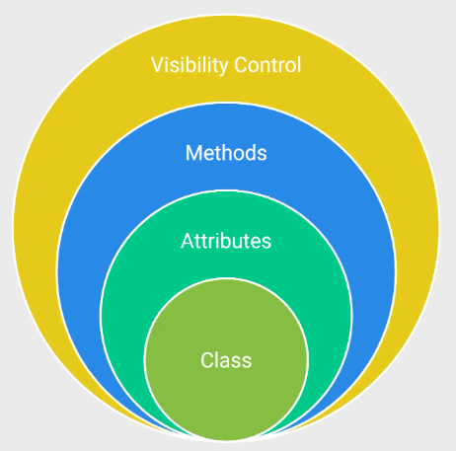
Encapsulation
Encapsulation is wrapping data in layers
Encapsulation is a process of:
Taking data from higher layer
Adding a header (sometimes trailer)
Passing it to the next lower layer
Each layer adds its own control information:
Addresses
Ports
Error checks
Other flags

Slide 8
Letter analogy (Letter in envelopes)
You write a message → put it in an envelope
Put that envelope into a bigger package
Put package on a truck
In networks:
Application data → segment → packet → frame → bits
Each “envelope” is a header added by a layer (Data → TCP header → IP header → Ethernet header)

Slide 9
Decapsulation
Decapsulation is unwrapping on the other side At the receiver:
Physical layer: receives bits
Data Link layer: reads frame, removes L2 header/trailer
Network layer: reads packet, removes IP header
Transport layer: reads segment, removes TCP/UDP header
Application: finally gets the original data
Each layer only understands its own header

Slide 10
PDU names by layer
PDUs are names of data at each layer PDU = Protocol Data Unit (it's just a fancy name for “data unit”)
Typical names:
Application / Presentation / Session: Data (Message)
Transport:
TCP → Segment
UDP → Datagram
Network: Packet
Data Link: Frame
Physical: Bits
Important concept: data is the same information but wrapped differently at each layer

Slide 11
Encapsulation and overhead
Encapsulation adds overhead Every header = extra bytes added to data
Useful, but not free:
More headers → bigger total size
Example (not exact, just idea):
Data: 1000 bytes
TCP header: 20 bytes
IP header: 20 bytes
Ethernet header + trailer: ~18 bytes
So network uses Maximum Transmission Unit (MTU) to limit frame size (e.g., 1500 bytes for Ethernet)

Slide 12
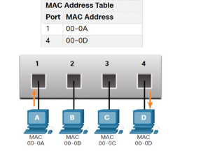
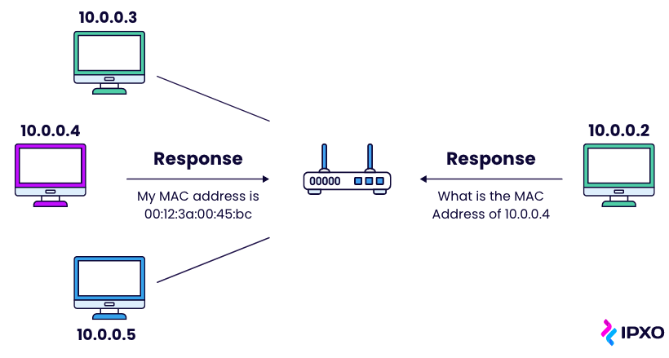
Addressing (MAC, IP, Port)
Why do we need different addresses?

Slide 13
Addressing (MAC, IP, Port)
In a network, we must answer:
Which device on the local network? → MAC address
Which network & device on the Internet? → IP address
Which application on that device? → Port number
One address type cannot solve everything, so we use all three together.

Slide 14
MAC address basics
- MAC Address is a local hardware ID -
MAC (Media Access Control) address it is a physical address burned into network card. It can be changed, but conceptually fixed. It is a 48-bit value, usually written as 6 hex pairs
Example: 00:1A:2B:3C:4D:5E

Slide 15
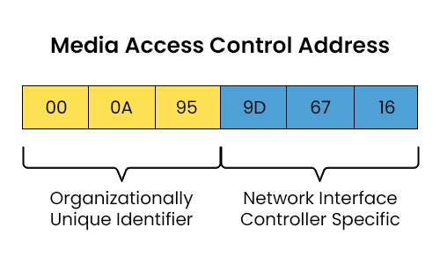
MAC address basics
MAC is used by the Data Link layer, to deliver frames inside the same LAN (example: your home Wi-Fi) MAC addresses work only within the same local network (broadcast domain)
Switches work mainly with MAC addresses

Slide 16
IP address basics (recap)
- IP Address – Logical Network Address -
IP address:
Identifies device + network at the Network layer
IPv4: 32-bit (example: 192.168.1.10)
IPv6: 128-bit (example: 2001:db8::1)
Routers use IP addresses to:
Decide where to forward packets
Connect different networks together (internetworking)
Routers ignore MAC addresses, they work only with IPs

Slide 17
Port number basics
A port is a number used at the Transport layer (TCP/UDP)
Used to separate traffic for different applications on the same machine
Example:
Same PC:
Browser uses port 54321 → server port 443 (HTTPS)
Messenger app uses port 54322 → server port 5222 (XMPP)
Without ports, OS couldn’t know which app should receive incoming data.

Slide 18
Port ranges & well-known ports
Ports are 16-bit numbers → 0 to 65535
Ranges:
0 – 1023: Well-known ports
1024 – 49151: Registered ports
49152 – 65535: Dynamic / private / ephemeral ports
Common well-known ports:
20/21 – FTP
22 – SSH
25 – SMTP (email)
53 – DNS
67/68 – DHCP
80 – HTTP
443 – HTTPS

Slide 19
One packet, three address types
When your browser connects to a web server:
- Frame (Data Link)
- Source MAC: your device’s NIC
- Destination MAC: your router’s NIC (next hop)
- Packet (Network)
- Source IP: your device’s IP
- Destination IP: server’s IP
- Segment (Transport)
- Source port: random high port (client)
- Destination port: 80 or 443 (web server)
- Address set sometimes called a socket pair:
- Src IP, Src Port, Dst IP, Dst Port

Slide 20
Transport Layer: TCP vs UDP
Transport Layer: End-to-End Delivery Main responsibilities:
Deliver data from application to application
Use port numbers
Handle reliability, ordering, flow control (if needed)
Two main protocols:
TCP (Transmission Control Protocol)
UDP (User Datagram Protocol)

Slide 21
TCP: reliable delivery
Connection-oriented:
Uses a 3-way handshake (SYN, SYN-ACK, ACK) before sending data
Features:
Reliable – retransmits lost segments
Ordered – reassembles data in correct order
Flow control – avoids overwhelming receiver
Congestion control – tries not to overload network
Used for:
Web browsing (HTTP/HTTPS)
Email (SMTP, IMAP, POP3)
File transfer (FTP)
Many apps where correctness is more important than speed

Slide 22
UDP: fast but unreliable
Connectionless:
No handshake, just send datagrams
Features:
No guarantee of delivery
No ordering, no retransmission
Very low overhead (small header, simple logic)
Used for:
DNS queries
Streaming audio/video
Online games
VoIP (voice calls)
Good when:
Some loss is ok, but low delay is important

Slide 23
TCP vs UDP at a glance
TCP
Reliable, ordered, heavier
For files, web pages, emails
UDP
Unreliable, unordered, lighter
For real-time apps (voice, video, gaming, DNS)
No protocol is “better” in general:
Choice depends on application needs

Slide 24
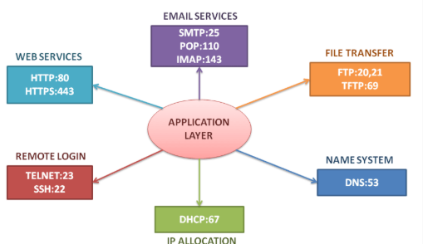
Application protocols
Provides services directly to the user or applications
Uses Transport layer (TCP/UDP) underneath
Today’s focus:
DHCP – Automatic IP configuration
HTTP/HTTPS – Web
FTP – File transfer
DNS – Name resolution

Slide 25
HTTP & HTTPS
HTTP (HyperText Transfer Protocol)
Used to request and deliver web pages, images, APIs
Default port 80, runs over TCP
Data is plain text → can be read if intercepted
HTTPS (HTTP Secure)
HTTP + TLS/SSL encryption
Default port 443, runs over TCP
Protects passwords, banking, personal data
Browser = HTTP/HTTPS client
Web server (Nginx, Apache, IIS) = server

Slide 26
FTP & SFTP
FTP (File Transfer Protocol)
Designed for uploading/downloading files
Typically uses:
TCP 21 for control commands
TCP 20 for data (active mode)
Sends user and password in clear text → not secure
Secure alternatives:
SFTP (SSH File Transfer Protocol) – uses SSH, usually port 22
FTPS – FTP over TLS encryption
Main idea: FTP = simple file transfer; in practice, we often prefer SFTP today

Slide 27
DNS – domain name system
Problem: Humans like names, networks use IP addresses
DNS converts:
www.google.com → IP address (IPv4 or IPv6)
Uses mainly:
UDP port 53 (standard queries)
TCP port 53 (zone transfers, large answers)
Basic query flow:
Client asks DNS resolver (usually your router or ISP)
Resolver asks other DNS servers if needed
Answer is cached to speed up next requests

Slide 28
DHCP - dynamic host configuration protocol
Without DHCP every device needs manual IP setup -> very hard in big networks. Cuz DHCP automatically provides: IP address , subnet mask, default gateway and DNS server(s) The server assigns addresses from an IP pool for a limited lease time
Uses UDP ports 67 and 68
Basic message sequence (simplified):
DISCOVER – Client: “Any DHCP server here?” (broadcast)
OFFER – Server: “I can give you IP X”
REQUEST – Client: “I want IP X from you”
ACK – Server: “OK, it’s yours for some time (lease)”

Slide 29
End-to-End
Example: from Wi-Fi to website
You connect to Wi-Fi
DHCP gives your device:
IP, mask, gateway, DNS server
You open browser and type www.example.com
DNS converts that name to the server’s IP
Browser uses TCP (port 443) to create connection to that IP
Over that TCP connection, it sends HTTPS requests
Router uses IP routing and MAC addresses to move packets
Server responds with web page, which your browser displays

Slide 30
Downloading a File
(HTTP vs FTP)
When you click a “Download” link on a website:
Usually happens over HTTP/HTTPS (port 80 or 443)
Browser handles it, shows progress bar
If using a dedicated FTP server:
You connect with an FTP client (e.g., FileZilla)
Enter username & password
FTP uses TCP port 21 for control, port 20 for data
Both achieve the same result — transferring files —
but FTP gives more control over remote directories.

Slide 31
The network as a city
Everything depends on cooperation between all layers.
A problem in any layer ->communication fails.
Layer | Real World Analogy | Example in Networking
Application | The user speaking a language | HTTP, FTP, DNS, DHCP
Transport | The postal service ensuring delivery | TCP or UDP
Network | City map & addresses | IP
Data Link | Delivery van on a street | MAC & Ethernet
Physical | The road itself | Cable, Wi-Fi signals

Slide 32
Test your understanding
What is encapsulation and why do we use it?
What’s the difference between MAC and IP addresses?
Why does the network need port numbers?
Which layer ensures reliable delivery?
Which protocol automatically gives your computer an IP address?
Which protocol turns names into IPs?
What’s the main difference between TCP and UDP?
Over which port does HTTPS operate?

